Slide 1
Database management systems
lecture 8. Introduction to SQL

Slide 2
Introduction to SQL
SQL functions fit into two broad categories:
Data definition language
SQL includes commands to:
Create database objects, such as tables, indexes, and views
Define access rights to those database objects
Data manipulation language
Includes commands to insert, update, delete, and retrieve data within database tables

Slide 3
Introduction to SQL (continued)
SQL is relatively easy to learn
Basic command set has vocabulary of less than 100 words
Nonprocedural language
American National Standards Institute (ANSI) prescribes a standard SQL
Several SQL dialects exist

Slide 4
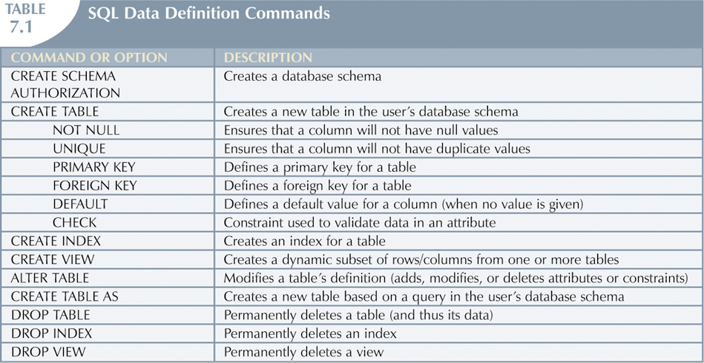
Introduction to SQL (continued)

Slide 5
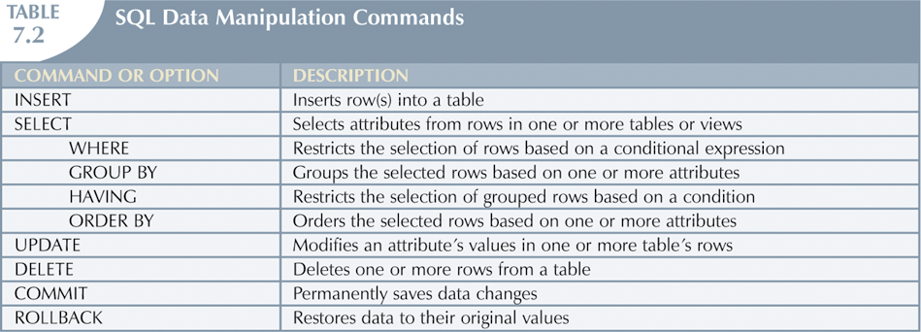
Introduction to SQL (continued)

Slide 6
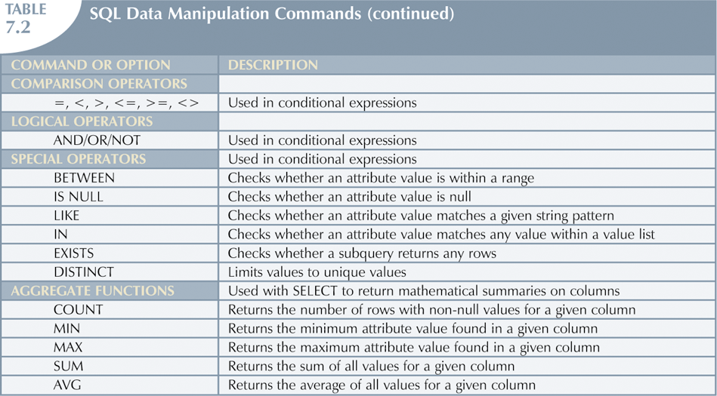
Introduction to SQL (continued)

Slide 7
Data Definition Commands
Examine simple database model and database tables that will form basis for many SQL examples
Understand data environment

Slide 8
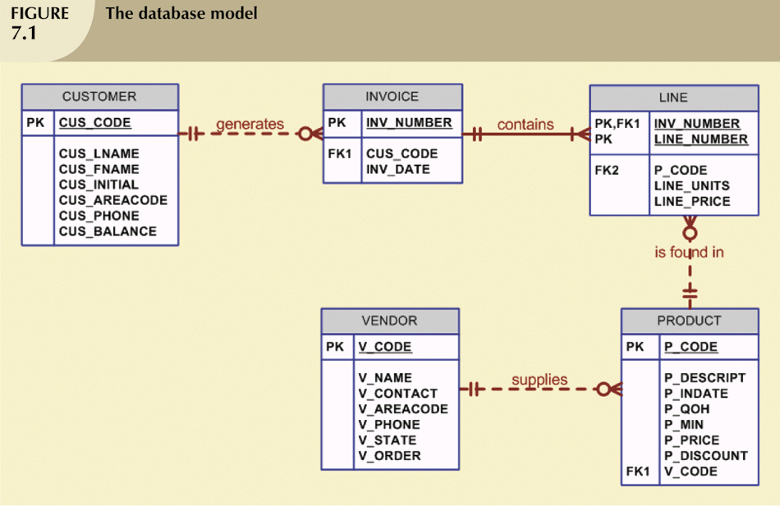
The Database Model

Slide 9
Creating the Database
Following two tasks must be completed:
Create database structure
Create tables that will hold end-user data
First task:
RDBMS creates physical files that will hold database
Tends to differ substantially from one RDBMS to another

Slide 10
The Database Schema
Authentication
Process through which DBMS verifies that only registered users are able to access database
Log on to RDBMS using user ID and password created by database administrator
Schema
Group of database objects—such as tables and indexes—that are related to each other

Slide 11
Data Types
Data type selection is usually dictated by nature of data and by intended use
Pay close attention to expected use of attributes for sorting and data retrieval purposes

Slide 12
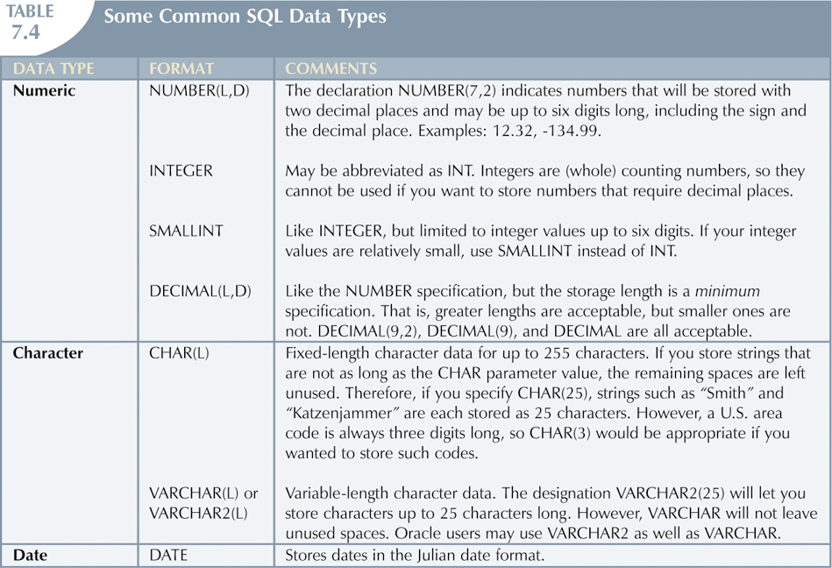
Data Types (continued)

Slide 13
Creating Table Structures
Use one line per column (attribute) definition
Use spaces to line up attribute characteristics and constraints
Table and attribute names are capitalized
NOT NULL specification
UNIQUE specification

Slide 14
Creating Table Structures (continued)
Primary key attributes contain both a NOT NULL and a UNIQUE specification
RDBMS will automatically enforce referential integrity for foreign keys
Command sequence ends with semicolon

Slide 15
SQL Constraints
NOT NULL constraint
Ensures that column does not accept nulls
UNIQUE constraint
Ensures that all values in column are unique
DEFAULT constraint
Assigns value to attribute when a new row is added to table
CHECK constraint
Validates data when attribute value is entered

Slide 16
SQL Indexes
When primary key is declared, DBMS automatically creates unique index
Often need additional indexes
Using CREATE INDEX command, SQL indexes can be created on basis of any selected attribute
Composite index
Index based on two or more attributes
Often used to prevent data duplication

Slide 17
Data Manipulation Commands
Adding table rows
Saving table changes
Listing table rows
Updating table rows
Restoring table contents
Deleting table rows
Inserting table rows with a select subquery

Slide 18
Adding Table Rows
INSERT
Used to enter data into table
Syntax:
INSERT INTO tablename VALUES (value1, value2, … , valuen);

Slide 19
Adding Table Rows
INSERT
Used to enter data into table
Syntax:
INSERT INTO tablename (col1, col2, … , coln) VALUES (value1, value2, … , valuen);

Slide 20
Adding Table Rows (continued)
When entering values, notice that:
Row contents are entered between parentheses
Character and date values are entered between apostrophes
Numerical entries are not enclosed in apostrophes
Attribute entries are separated by commas
A value is required for each column
Use NULL for unknown values

Slide 21
Listing Table Rows
SELECT
Used to list contents of table
Syntax:
SELECT columnlist FROM tablename;
Columnlist represents one or more attributes, separated by commas
Asterisk can be used as wildcard character to list all attributes

Slide 22
Updating Table Rows
UPDATE
Modify data in a table
Syntax:
UPDATE tablename SET columnname = expression [, columname = expression] [WHERE conditionlist];
If more than one attribute is to be updated in row, separate corrections with commas

Slide 23
Deleting Table Rows
DELETE
Deletes a table row
Syntax:
DELETE FROM tablename [WHERE conditionlist ];
WHERE condition is optional
If WHERE condition is not specified, all rows from specified table will be deleted

Slide 24
Inserting Table Rows with a Select Subquery
INSERT
Inserts multiple rows from another table (source)
Uses SELECT subquery
Query that is embedded (or nested) inside another query
Executed first
Syntax:
INSERT INTO tablename SELECT columnlist FROM tablename;

Slide 25
Selecting Rows with Conditional Restrictions
Select partial table contents by placing restrictions on rows to be included in output
Add conditional restrictions to SELECT statement, using WHERE clause
Syntax:
SELECT columnlist FROM tablelist [ WHERE conditionlist ] ;

Slide 26
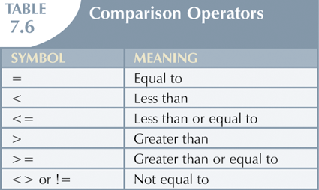
Selecting Rows with Conditional Restrictions (continued)

Slide 27
Arithmetic Operators: The Rule of Precedence
Perform operations within parentheses
Perform power operations
Perform multiplications and divisions
Perform additions and subtractions

Slide 28
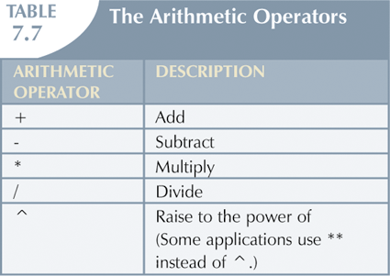
Arithmetic Operators: The Rule of Precedence (continued)

Slide 29
Special Operators
BETWEEN
Used to check whether attribute value is within a range
IS NULL
Used to check whether attribute value is null
LIKE
Used to check whether attribute value matches given string pattern

Slide 30
Special Operators (continued)
IN
Used to check whether attribute value matches any value within a value list
EXISTS
Used to check if subquery returns any rows

Slide 31
Advanced Data Definition Commands
All changes in table structure are made by using ALTER command
Followed by keyword that produces specific change
Following three options are available:
ADD
MODIFY
DROP

Slide 32
Changing a Column’s Data Type
ALTER can be used to change data type
Some RDBMSs (such as Oracle) do not permit changes to data types unless column to be changed is empty

Slide 33
Changing a Column’s Data Characteristics
Use ALTER to change data characteristics
If column to be changed already contains data, changes in column’s characteristics are permitted if those changes do not alter the data type

Slide 34
Adding a Column
Use ALTER to add column
Do not include the NOT NULL clause for new column

Slide 35
Dropping a Column
Use ALTER to drop column
Some RDBMSs impose restrictions on the deletion of an attribute

Slide 36
Copying Parts of Tables
SQL permits copying contents of selected table columns so that the data need not be reentered manually into newly created table(s)
First create the PART table structure
Next add rows to new PART table using PRODUCT table rows

Slide 37
Adding Primary and Foreign Key Designations
When table is copied, integrity rules do not copy, so primary and foreign keys need to be manually defined on new table
User ALTER TABLE command
Syntax:
ALTER TABLE tablename ADD PRIMARY KEY(fieldname);
For foreign key, use FOREIGN KEY in place of PRIMARY KEY

Slide 38
Deleting a Table from the Database
DROP
Deletes table from database
Syntax:
DROP TABLE tablename;

Slide 39
Advanced Select Queries
SQL provides useful functions that can:
Count
Find minimum and maximum values
Calculate averages
SQL allows user to limit queries to only those entries having no duplicates or entries whose duplicates may be grouped

Slide 40
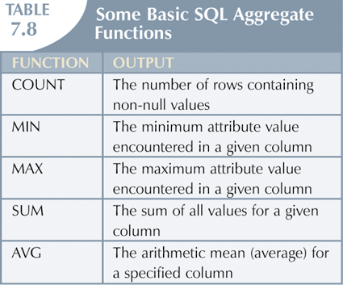
Aggregate Functions

